Slide 1
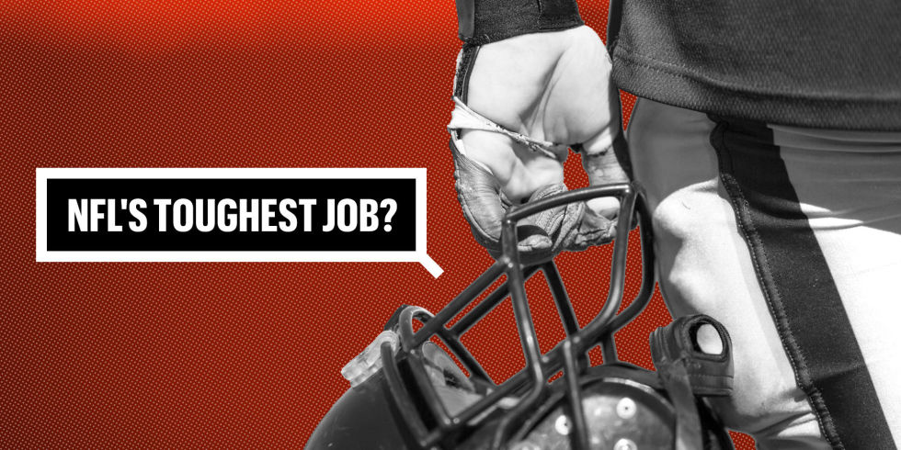
TEAM -3
NFL SALARY PREDICTION
Ashish Gupta Guanwei Tao Nachiket Garge Sindhushree Sonnad Matt Ziou Zhang
Feature 1
Feature 2
Feature 3

Slide 2
Objective
As a team, learn predictive modelling concepts through applying SEMMA approacheffectively. Research and learn about NFL as an example to build a predictive model. Based on team experiential learning process with this project, to better understand the data exploration, data visualization, pattern discovery, modelling and better interpret results obtained from the model.
Build a predictive model with enough capacity to predict the salaries of future free agents based on their previous performance and salary information.

Slide 3


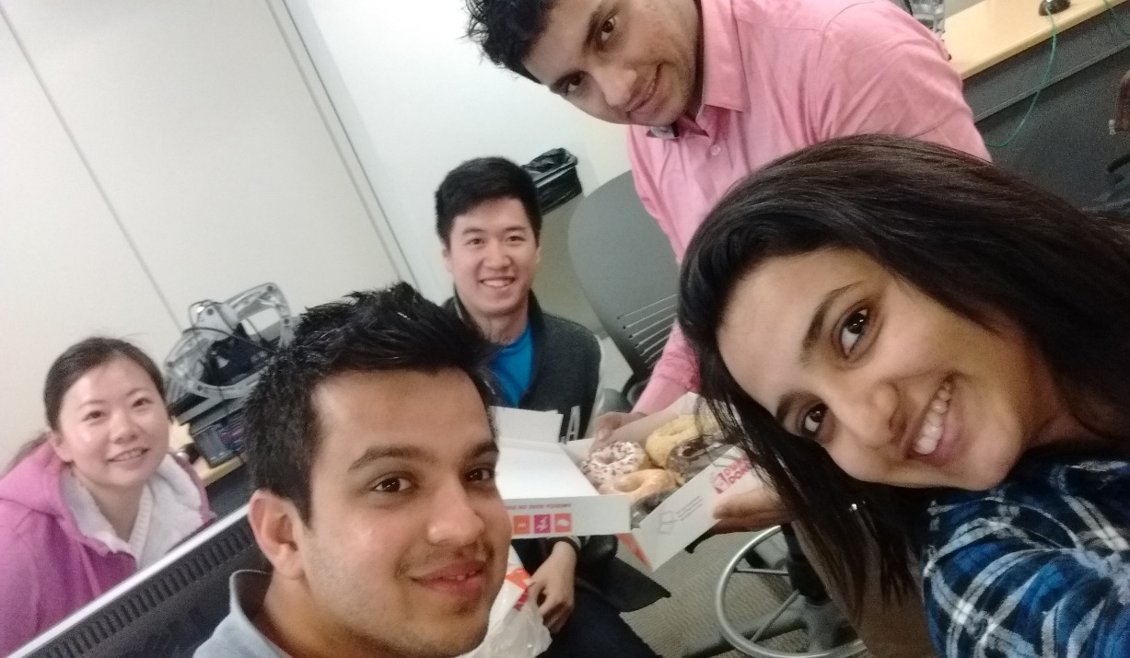


Slide 4

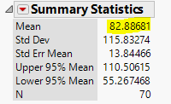
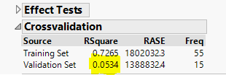
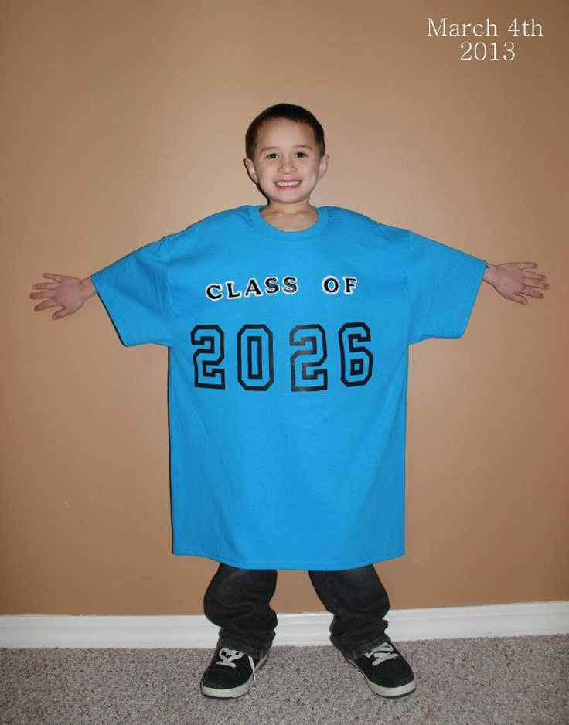
First Idea
Collected data for “Free Agents” of every year and modelled it.
Error performance
Validation Check
Overfitted!

Slide 5
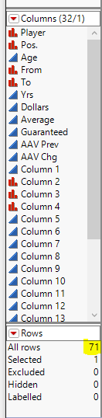


THE Problem
Limited Data
The main problem in this model was the limited number of rows available for analysis. For all five years, only 70 quarterback free agents available!
Add more rows!
But How?

Slide 6
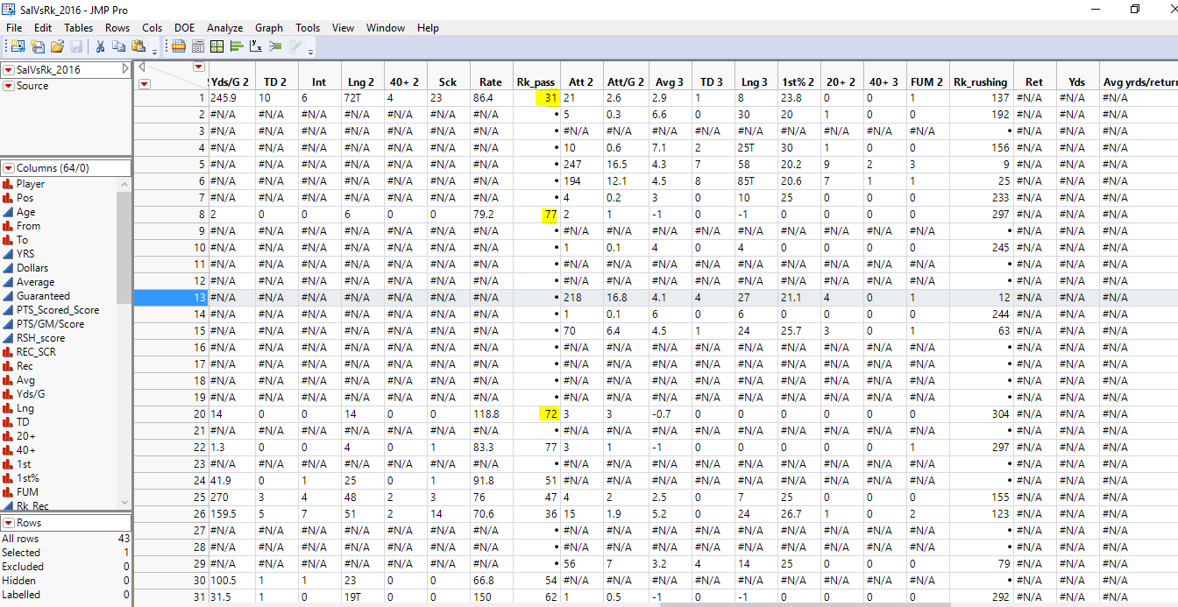

Second Idea
Merged Free agents for different positions
Problem : Lot of Missing values
Performance measures of different positions are not same. ☹

Slide 7

Third Idea
PLAN to add data of all quarterbacks together, in order to make a model.
Free agents data
Data for other quarterbacks from online resources
Merge 2 data sets.

Slide 8
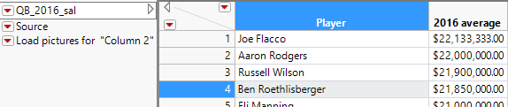
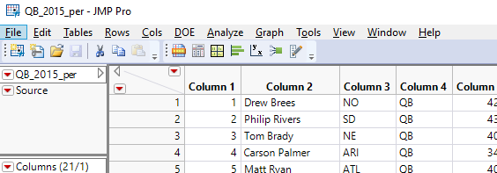
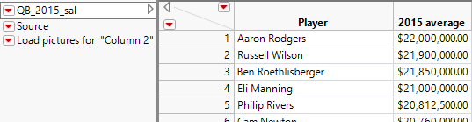

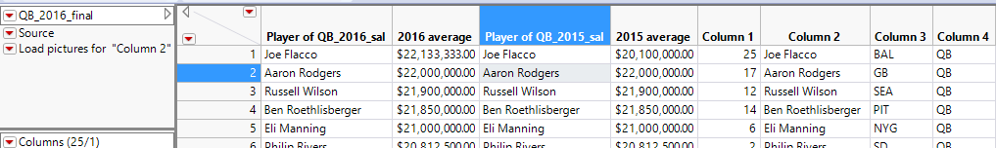

Data Collection and Consolidation
Merged these 3 sheets for all 5 years.
Merged all the 5 Final files, and added a year column to make “One Final Sheet”.

Slide 9
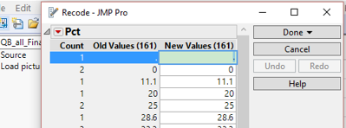
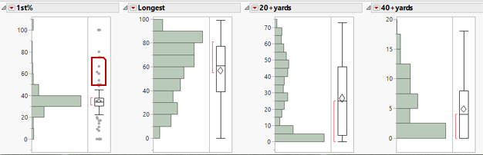
Data Preprocessing
01
Data Sampling
02
Data Cleanup
03
Outlier analysis and Hypotheis

Slide 10

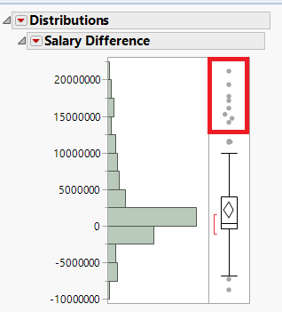
Outlier Analysis
There is no any outliers in our data since the number of rows are too less to confirm it. However, some rows are excluded that have very high current salary as compared with previous year’s salary.
Rational: The variation in performance variables isn’t sufficient to predict very high raises in salaries.

Slide 11
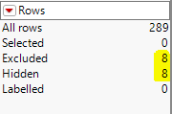
Outlier Analysis (Cont.)
Variance in performance variables is relatively too less to predict huge difference in salary.
Total 8 Outliers ☺

Slide 12
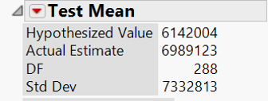
Hypothesis Testing
It’s important to explore whether the mean of current year average salaries differ significantly from the mean of previous year average salaries or not.
H₀ Pre Avg. = Current Avg. Thus, H_{A} Pre Avg. ≠ Current Avg.
Hypothesized Mean is $6,142,004 Event: From the data, the actual estimate comes out to be $6,989,123.
Hypothesis and Event

Slide 13
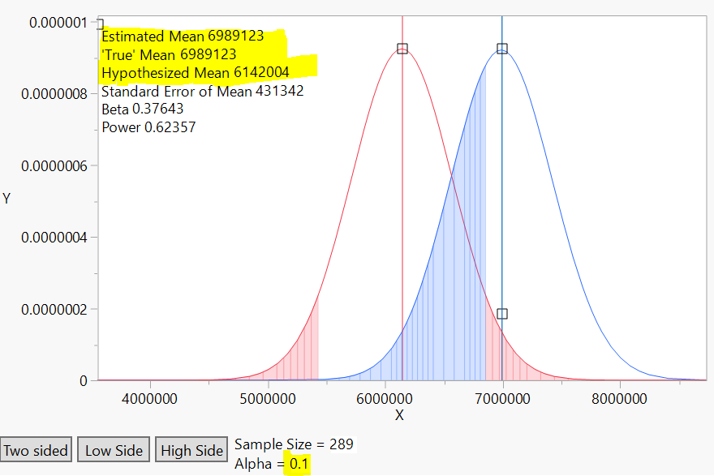
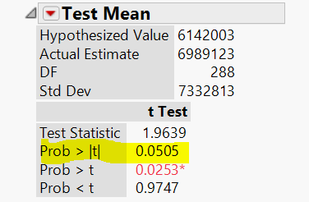
Hypothesis Testing
Hypothesis Testing Power plot
Clearly, with α error set to 10% It shows that occurrence of this event is rare and since it has occurred : It does not fail to reject Null Hypothesis Thus, Alternate Hypothesis gets accepted!

Slide 14
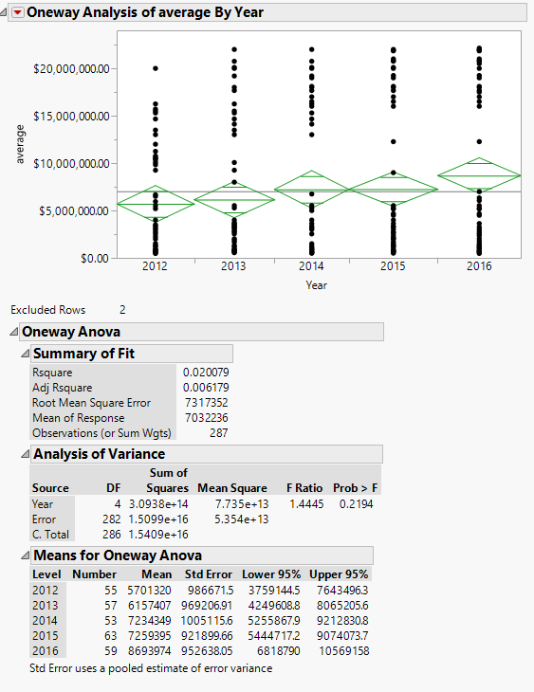
Proof of Hypothesis
As evident from the visualization the salary increases every year.
Thus, Current salary mean is slightly greater than previous salary mean as explained earlier.

Slide 15
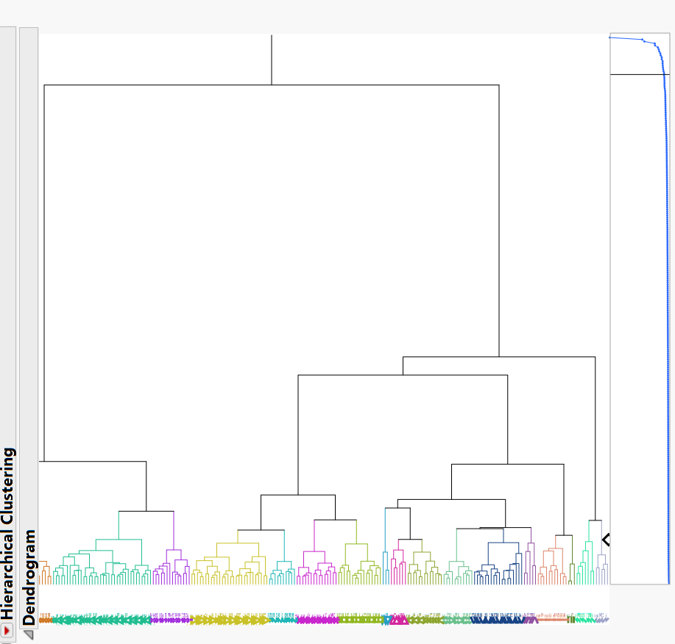
Cluster Analysis
Hierarchical cluster analysis to identify underlying pattern of performance variables with average salary.

Slide 16


Slide 17

Research and Modifications
Rating – Measure that captures most of the highly correlated performance measures.
Rating = (25 Att +1000 comp+50 Yads+4000td-5000int)/12att
Preferred Rating over PCA as it captures the performance variables as well as it has business sense.

Slide 18
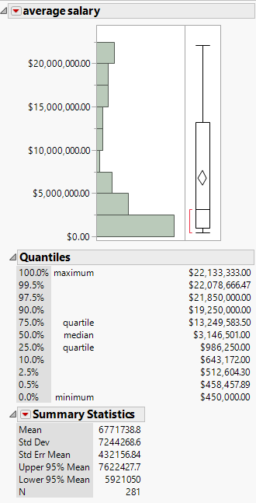
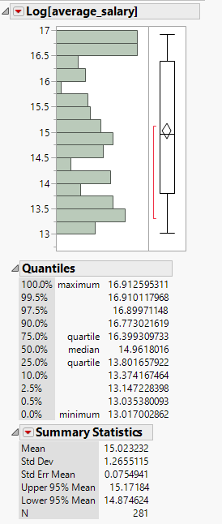
Transformation Of Variables
Salary
Log salary
Why Log Transformation?
To narrow down the range as average salaries had huge variations, ranging from $450,000 to $22,133,333.
Easy reconversion to interpret the final results.

Slide 19

Modeling
Target Variable – AVERAGE SALARY
A continuous variable, continuous models:
Model 1
Model 2
Model 3
Linear Regression
Neural Networks
Decision Tree

Slide 20

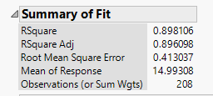

Model 1 – Linear Regression
Effect Summary
Modelling suggests previous salary, 1st play attempts, year and QB_rating as significant variables in predicting next year’s salary
These variables explain 89% of variation in predicting next year’s salary.
All the predictor variables are independent of each other, which shows there is no multicollinearity.
Summary of Fit
Cross Validation

Slide 21
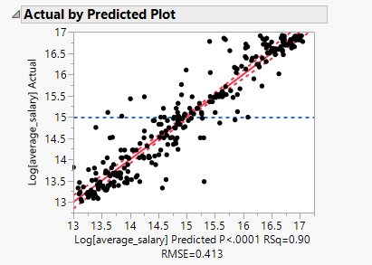
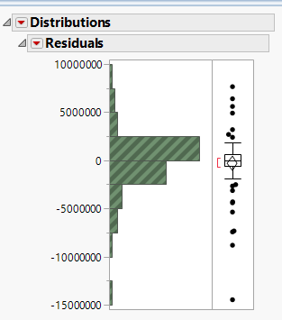
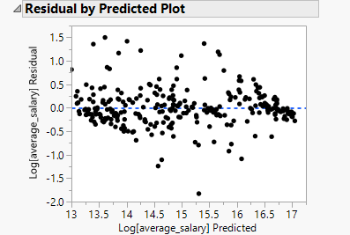
Validating Regression Assumptions
Linearity
Normal Distribution
Homoscedasticity

Slide 22
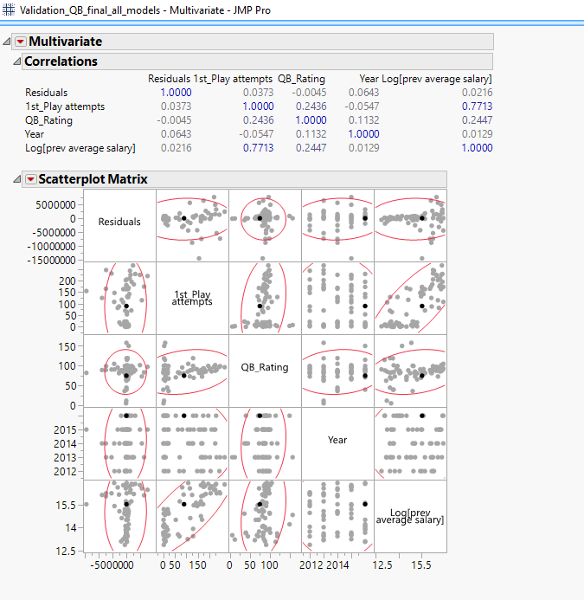

Validating Regression Assumptions (Cont.)
Independence of Residuals
No Correlation of Residuals with Predictor variables.

Slide 23
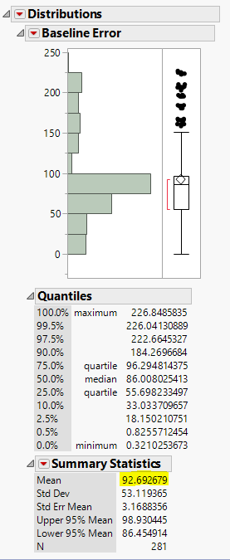
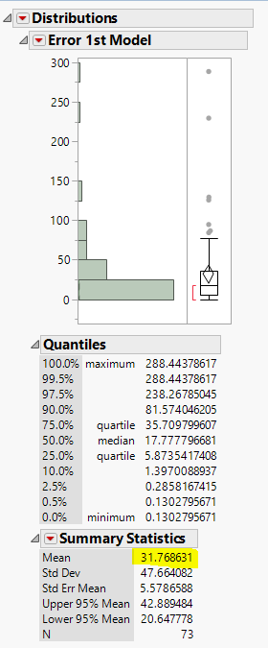

Error Performance
Baseline Error
Model Error

Slide 24
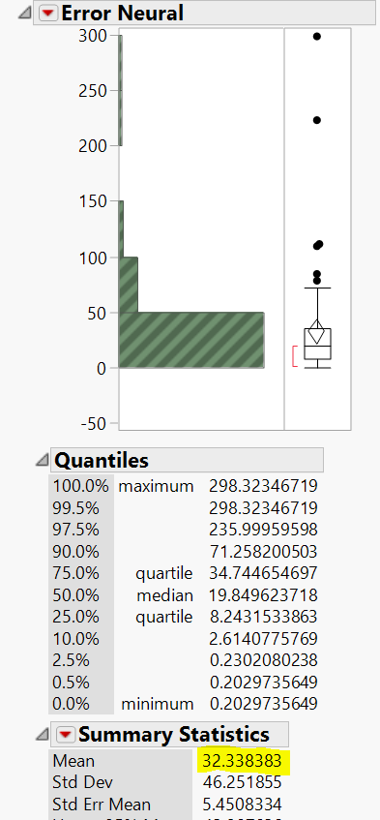
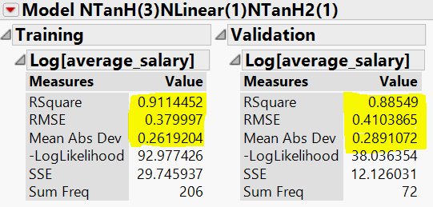
Model 2 – Neural Network
Error Performance
Neural Network predicts a better fit model but error on validation is slightly higher than linear regression.
Summary of Fit

Slide 25
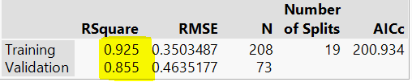
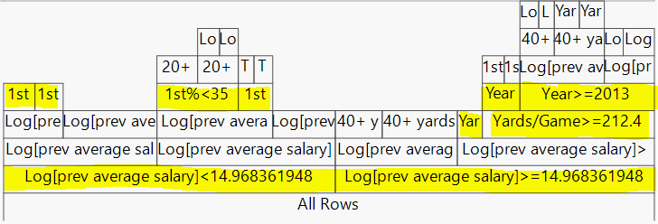
Model 3 – Decision Tree
Decision tree model provides the best fit training model but it seems slightly over fit.
Insights!
Model provides supportive evidence to chosen independent variables in regression model as splits are based on these variables
Initial splits based on previous average. Thus, identified as the most powerful predictor variable.
Decision Tree Best Split State

Slide 26
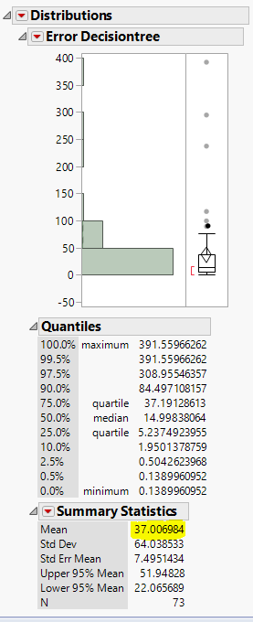
Error Comparison
Baseline Error
Regression
Neural
Decision Tree

Slide 27
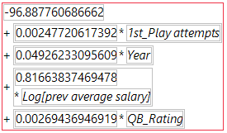
Best Model! – Linear Regression
Regression Formula:
3
Best Error Performance
31.76%
2
Business Use
Predictor Varables/Easy prediction formular
1
No Hidden Issues
Multicollinearty and overfitting

Slide 28
Future Plans
35%
5%
Prepare a model for all the positions following same approach as followed for quarterbacks.
Update the model by adding the data of coming years, once it is available.
5%
55%
Look for other leagues, college level competitions etc. to collect additional performance data.
Incorporate physical characteristics like height and weight of players to available performance data and conduct a comprehensive analysis.

Slide 29
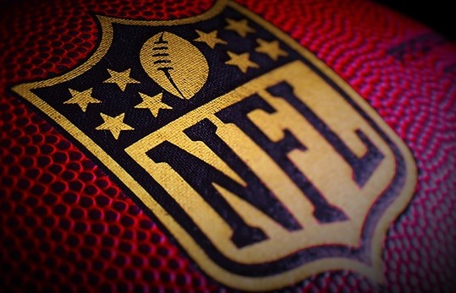
THANK YOU

